Slide 1
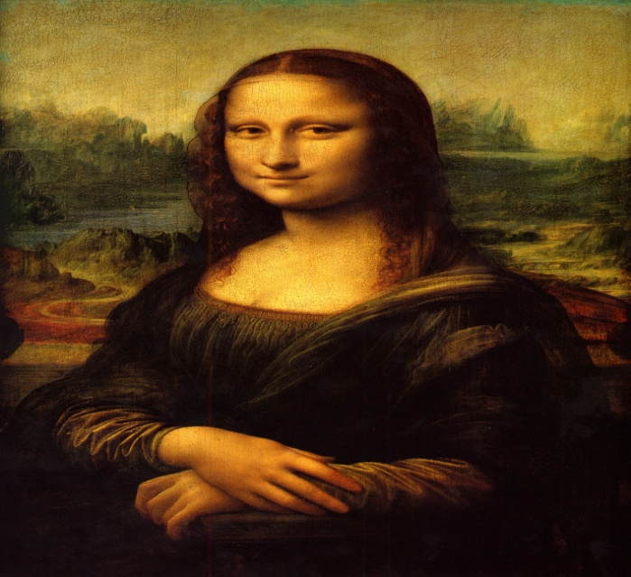
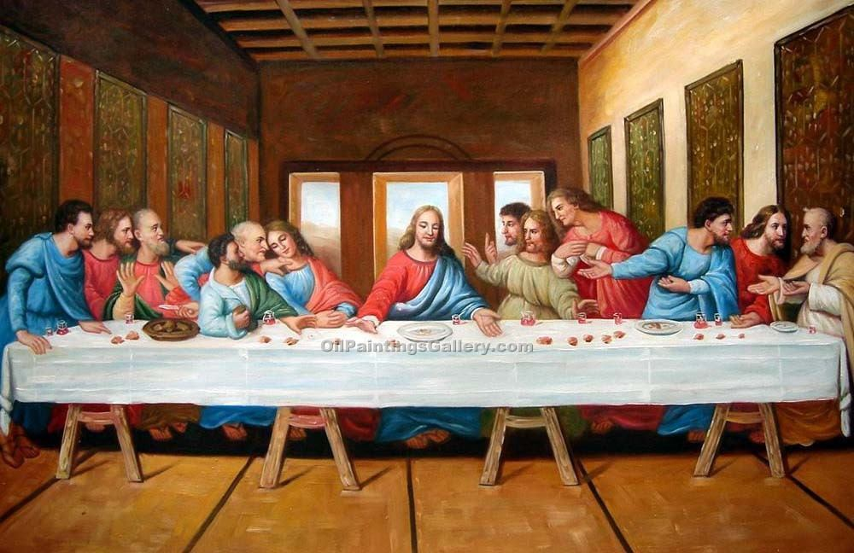
Leonardo daVinci
BY: Ian Kim & Scott Kim
VS

Slide 2
What is the name of the artist you chose and give a brief summary of their life.
Leonardo da Vinci is widely considered to be one of the best painters of all time. He was born in April 15, 1452 and he died in May 2, 1519. One of his painting Mona Lisa is the most parodied portrait and The Last Supper is the most reproduced religious painting of all time.

Slide 3
What are most famous compositions of your artist?
One of his most famous composition is the art called, Mona Lisa. I used the website, www.wikipedia.com. The time it was painted was between 1503 and 1506. The period of art is from the High Italian, 16th century.
The Last Supper is a late 15th century mural painting by Leonardo da Vinci in the refectory of the Convent of Santa Maria della Grazie, Milan. The work is presumed to have been commenced around 1495 and was commissioned as part of a scheme of a renovations to the church.

Slide 4
Describe each of the compositions. What are creative techniques that is used on the work of art?
The Mona Lisa is a half-length portrait of a woman by the Italian artist Leonardo da Vinci, the most visited, the most written about, the most sung about, the most parodied work of art in the world. He used symmetry that means to measure together. For example since the face is in the middle and other elements balance out on the sides.
The Last Supper is the famous painting for Leonardo da Vinci. He used depth and shading to make it look more realistic. He used fresco style technique. Fresco style means a technique of mural painting executed upon freshly laid lime plaster. Fresco means fresh and fresco technique has been employed since is closely associated with Italian Renaissance that means re-birth or re-born.

Slide 5
What is a brief summary of the historical culture in which your artist known?
Leonardo da Vinci was a scientist, mathematician, engineer, inventor, anatomist painter, sculptor, architect, botanist, musician, and a writer. And people knew Verrocchio was the best sculptor of his time.

Slide 6
Was your artist inspired by any other artists?
At first, Leonardo wasn’t influenced by any one. As a child, Leonardo was curious and wanted to learn how nature worked. He got his start as an artist around 1469, when his father employed him as an apprentice to the fabled workshop of Verrocchio. After, he went to there he was inspired by Andrea del Verrocchio.

Slide 7
What inspired you about this artist’s compositions?
Leonardo’s painting, “Mona Lisa” and “The Last Supper” paintings inspired me about this artist composition. His paintings were one of the most famous ones of all time, so I chose this one. I will use depth and shading just like how Leonardo da Vinci did.

Slide 8
☺REFRENCES☺
www.wikipedia.comwww.bing.com
www.google.com

